Slide 1
CREDIT EDA
Vishwanath Rajasekaran
EPGPDS
September 2022

Slide 2
Business Objective
This case study aims to identify patterns which indicate if a client has difficulty paying their instalments which may be used for taking actions such as denying the loan, reducing the amount of loan, lending (to risky applicants) at a higher interest rate, etc. This will ensure that the consumers capable of repaying the loan are not rejected. Identification of such applicants using EDA is the aim of this case study.
In other words, the company wants to understand the driving factors (or driver variables) behind loan default, i.e. the variables which are strong indicators of default. The company can utilize this knowledge for its portfolio and risk assessment.
To develop your understanding of the domain, you are advised to independently research a little about risk analytics - understanding the types of variables and their significance should be enough.

Slide 3
Steps Followed
Imported the data set (applications) into the Python Environment
Checked and removed unwanted/ NaN values which is more than 30% columns from the dataset.
Dropped unwanted rows which has XNA values.
Created bins of Income and Credit to analyze.
Changed full form for the short form data like “TARGET”.
Bifurcated application dataset into two with the help of “TARGET”.
Customers who has payment difficulties.
Customers all other cases.
Performed Univariate / Bivariate Analysis for both the dataset.
Imported the data set (Previous Application) into the Python Environment
Removed the columns which has NaN values more than 30%, removed XNA and XAP variables.
Merged (Previous Application & Application) data set using SK_ID_CURR
Renamed column and removed unwanted column for better understanding.
Performed Univariate / Bivariate Analysis for both the dataset.

Slide 4
Application Dataset

Slide 5
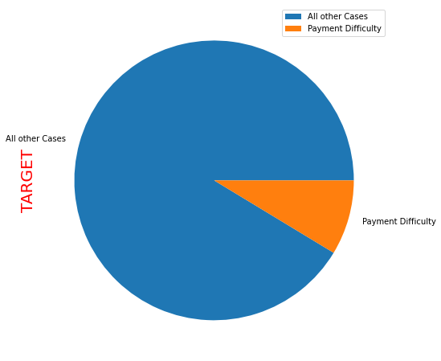
Application Data Set
Application Dataset has two target customers.
Customers who has payment difficulties
Customers who has clearing the payment on time.
Hence, Segregating Two into different data set to analyze

Slide 6
Application Dataset
Target – 1 (Customer with Payment Difficulties)

Slide 7
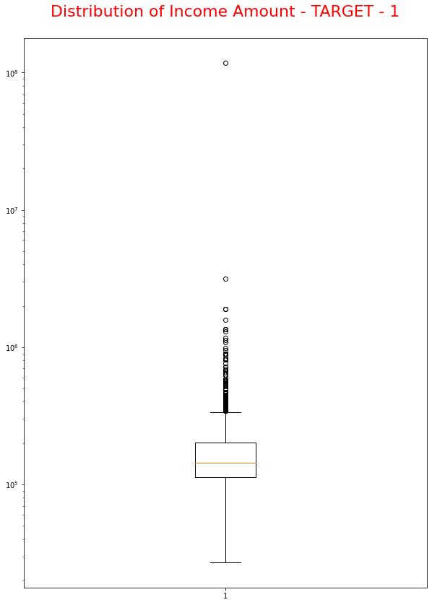
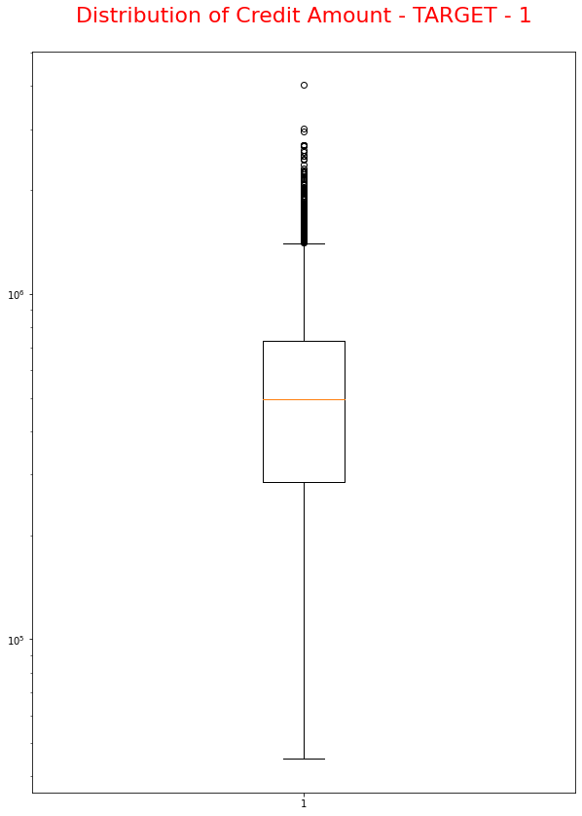
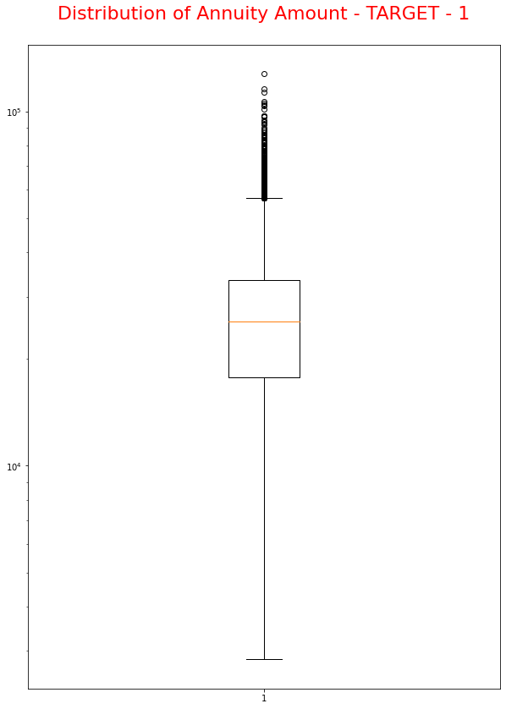
Application Data Set - Target – 1
Observation
Some outliers are noticed in Income amount.
Observation
Some outliers are noticed in credit amount.
The spread in 25th quartile is bigger than 75th quartile for credit amount which means most of the credits of clients are present on the 25th quartile.
Observation
Some outliers are noticed in credit amount.
The spread in 25th quartile is bigger than 75th quartile for credit amount which means most of the credits of clients are present on the 25th quartile.

Slide 8
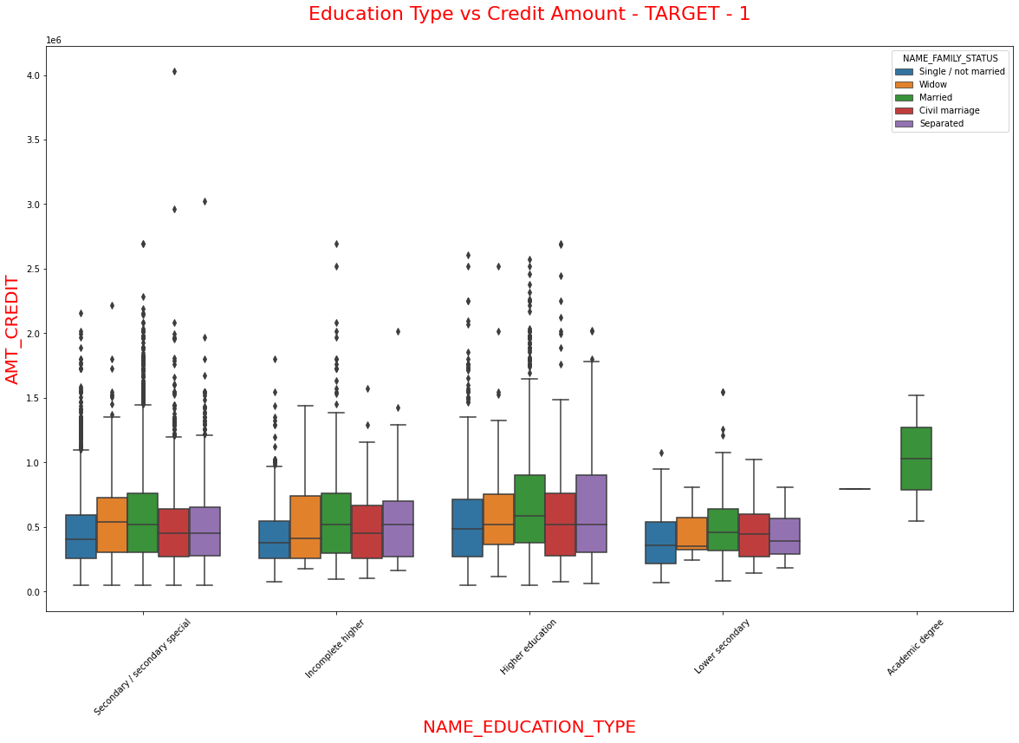
Application Data Set - Target – 1
OBSERVATION
Married is consistently maintaining in Median and has maximum spread.
Customer of Married and Single/Not Married who has a academic degree only holding Credit amount in that category.
Customer who has Secondary education and Civil Marriage hold maximum credit in this category.
Minimum credit falls in 45,000 spreaded across all Family status and Educational type.

Slide 9
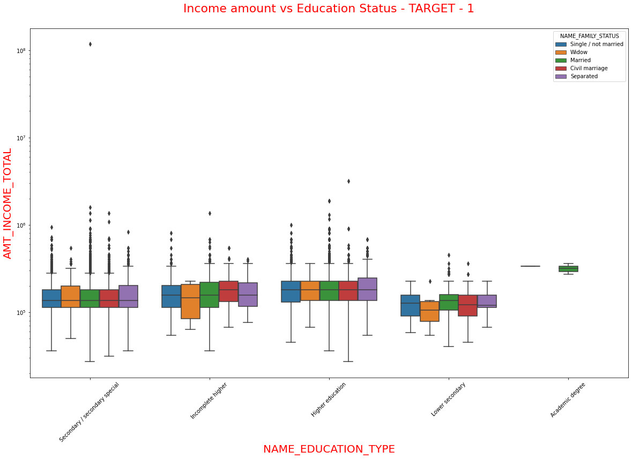
Application Data Set - Target – 1
OBSERVATION
Minimum income is <50,000 falls under Secondary special Education and Married status.
Secondary education with married Family status holding higher salary.

Slide 10
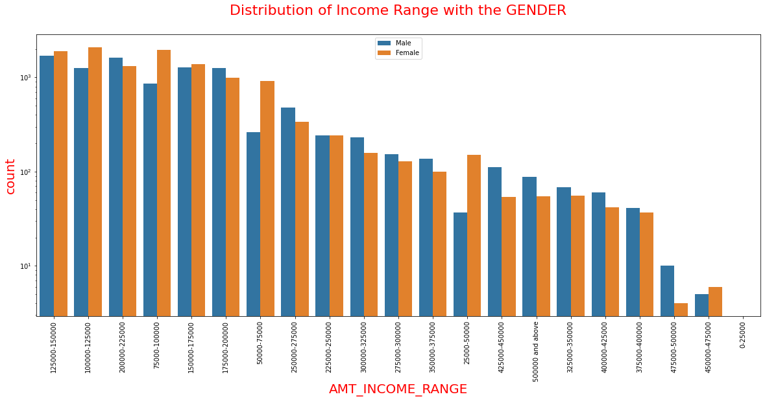
Application Data Set - Target – 1
OBSERVATION
Female counts on Income range is higher thatn Male.
Income range from 75000 to 200000 has wide spread.
Spread is very less from income range of 4,00,000 and above and no spread in 25000 category.

Slide 11
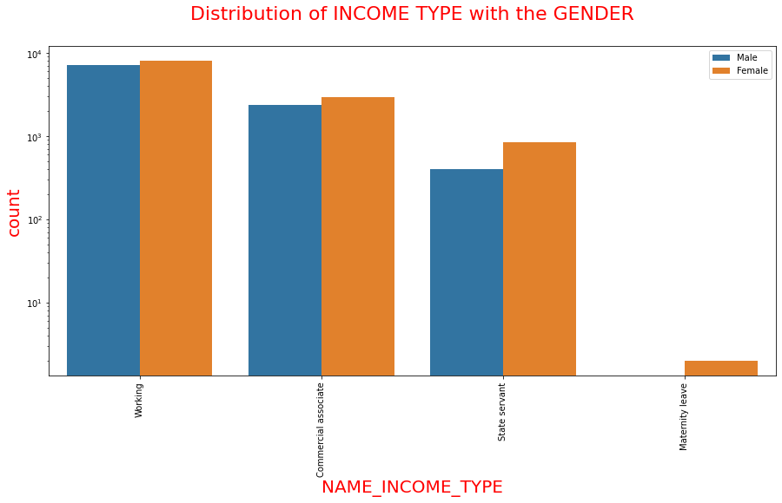
Application Data Set - Target – 1
OBSERVATION
The customers in the income type ‘working’, ’commercial associate’, and ‘State Servant’ has the higher spread than other.
Females are having more number of spread than the male.
Less number of spread for income type ‘Maternity leave’.

Slide 12
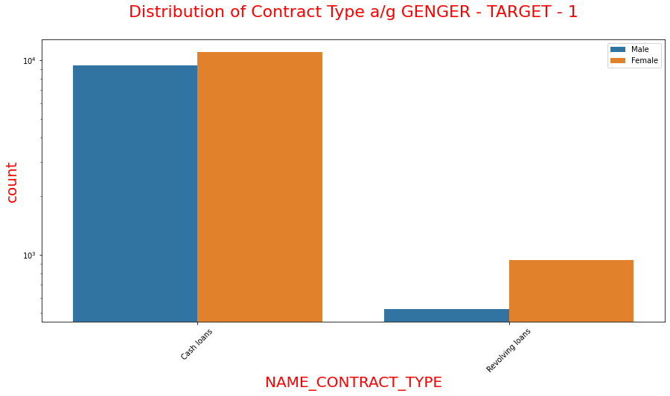
Application Data Set - Target – 1
OBSERVATION
For contract type ‘cash loans’ is having higher number of spreads than ‘Revolving loans’.
Female is having huge spread for applying credit loan.
Revolving Loans - Female spread is huge than male.

Slide 13
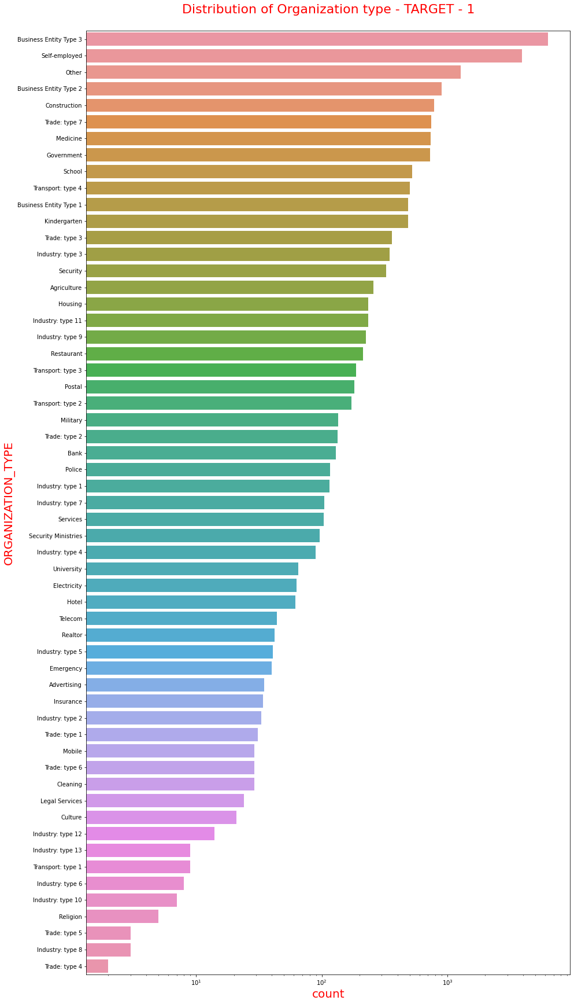
Application Data Set - Target – 1
OBSERVATIONS
High Customer who have applied for credit are from the organization type Business entity Type 3 , Self employed , Other etc..
Low Customer who have applied for credit are from Industry type 8,type 6, type 10 etc..

Slide 14
Application Dataset
Target – 0 (Customer with All Other Cases)

Slide 15
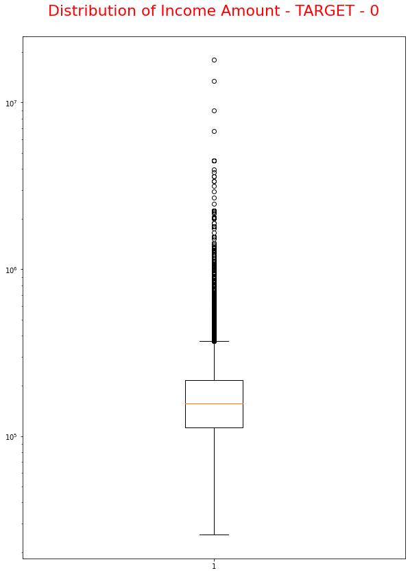
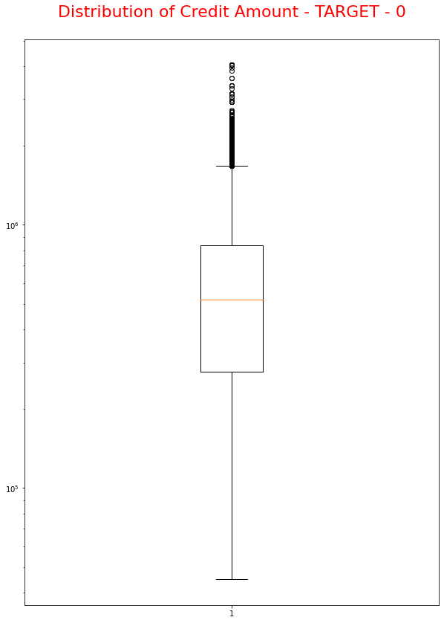
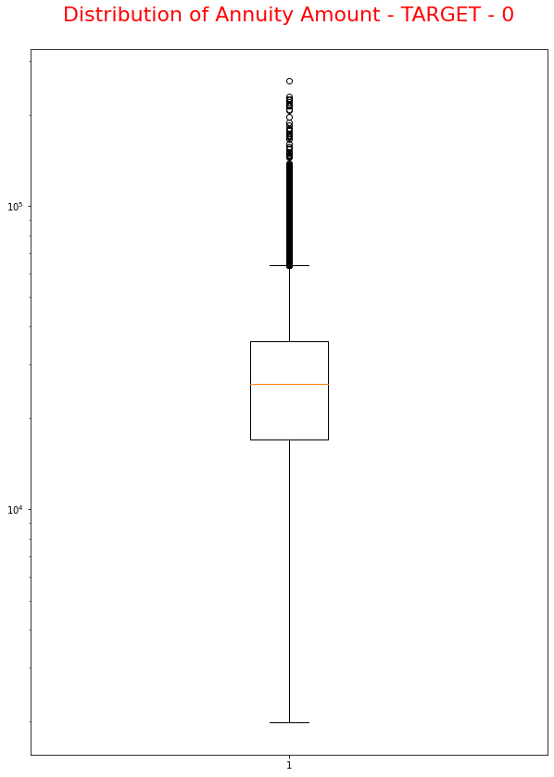
Application Data Set - Target – 0
Observation
Outliers are observed in income amount in Box Plot.
Observation
Some outliers are noticed in credit amount.
The spread in 25th quartile is bigger than 75th quartile for credit amount which means most of the credits of clients are present on the 25th quartile.
Similar to Target 1 customers
Observation
Some outliers are noticed in credit amount.
The spread in 25th quartile is bigger than 75th quartile for Annuity amount which means most of the credits of clients are present on the 25th quartile.
Similar to Target 1 customers.

Slide 16
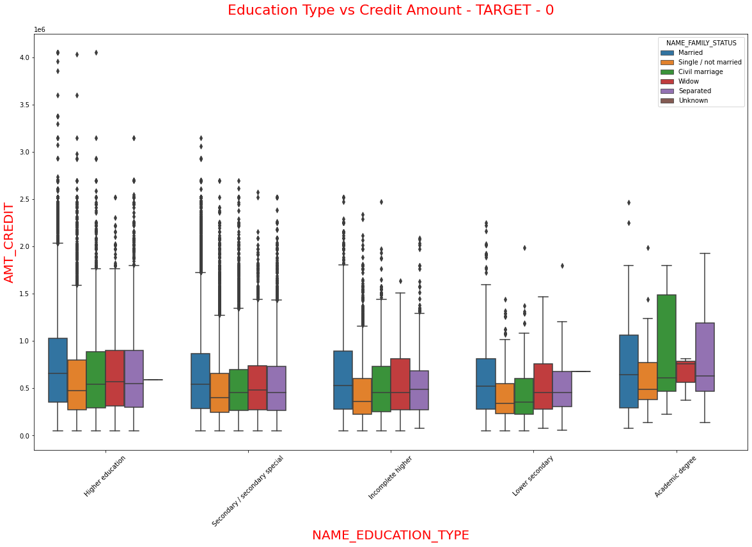
Application Data Set - Target – 0
OBSERVATION
Married is spreader across all educational categories.
Customer who has higher education holds maximum credit in this category.
Minimum credit falls in 45,000 spreader across all Family status and Educational type.

Slide 17
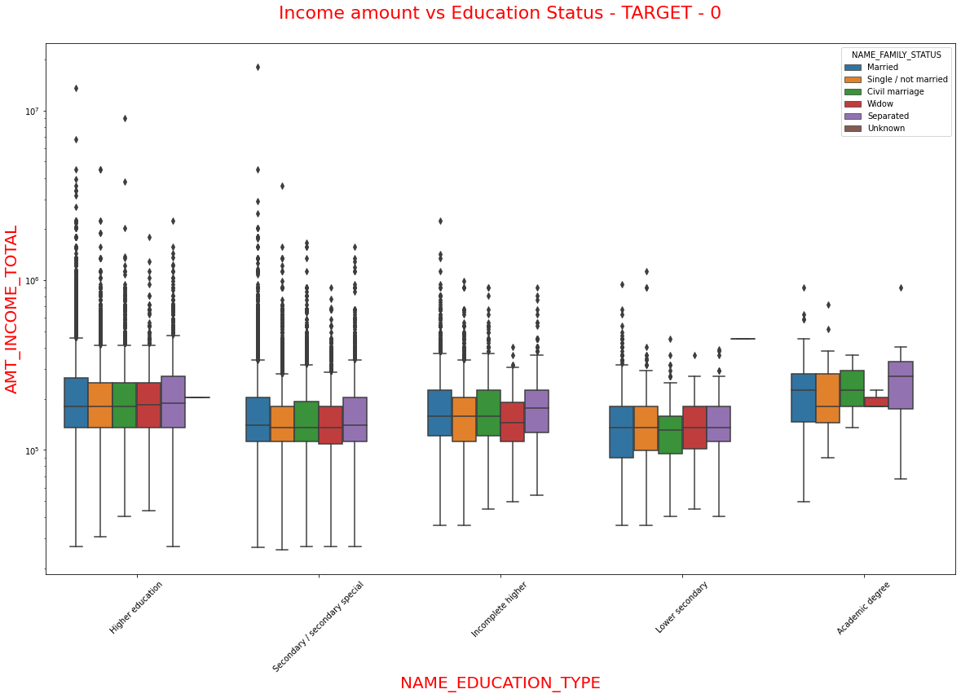
Application Data Set - Target – 0
OBSERVATION
Minimum income is <50,000 falls under Secondary special Education and Married status.
Secondary education with married Family status holding higher salary.

Slide 18
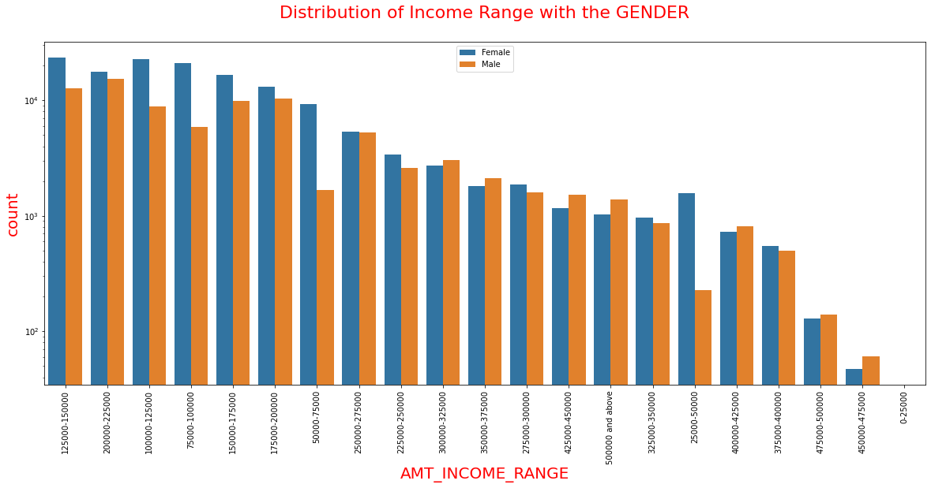
Application Data Set - Target – 0
OBSERVATION
Female counts on Income range is higher than Male.
Income range from 75000 to 200000 has wide spread.
Spread is very less from income range of 4,00,000 and above and no spread in 25000 category

Slide 19
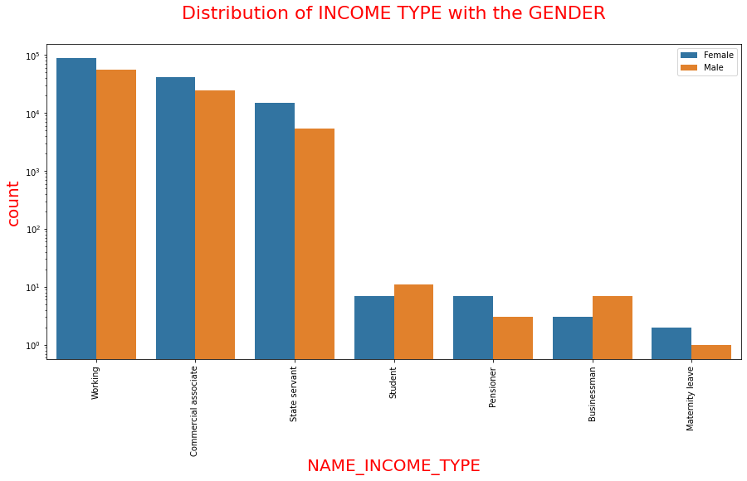
Application Data Set - Target – 0
OBSERVATION
The customers in the income type ‘working’, ’commercial associate’, and ‘State Servant’ has the higher spread than other.
Females are having more number of spread than the male.
Compared to Target -1, we have more categories.

Slide 20
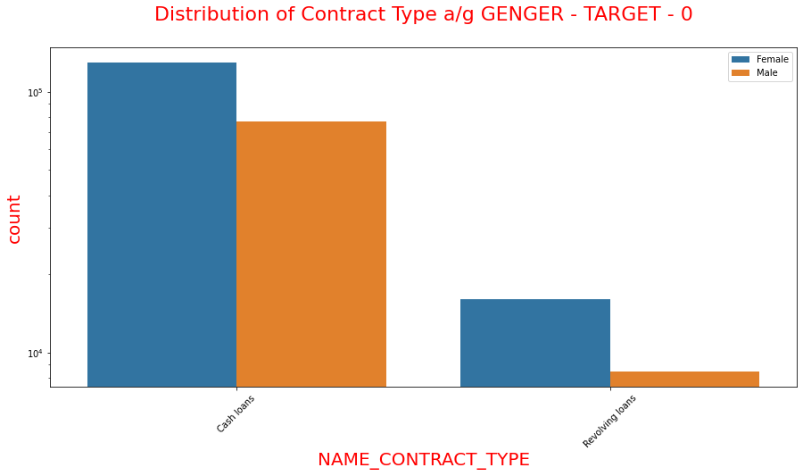
Application Data Set - Target – 0
OBSERVATION
For contract type ‘cash loans’ is having higher number of spreads than ‘Revolving loans’.
Female is having huge spread for applying credit loan.
Revolving Loans - Female spread is huge than male.

Slide 21
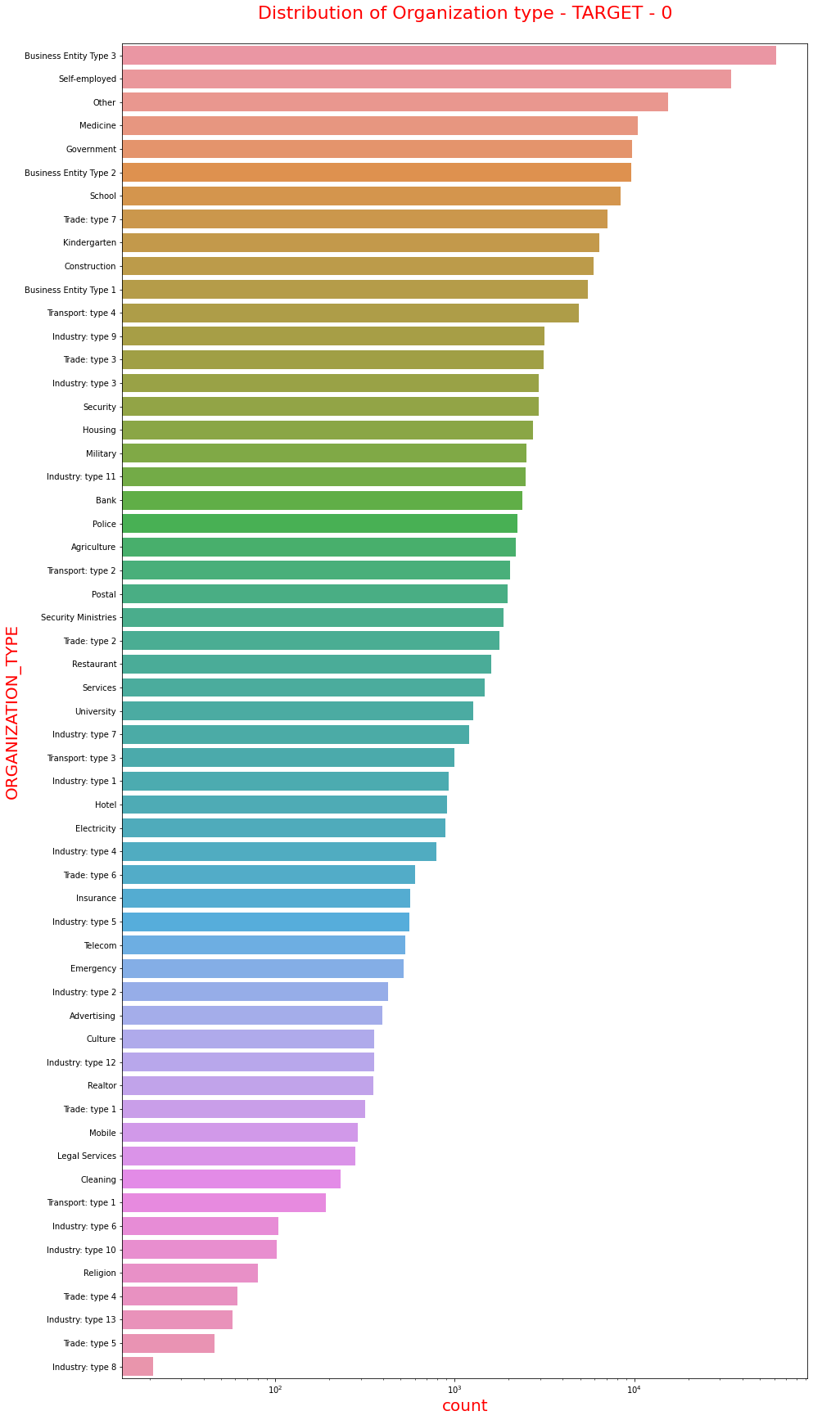
Application Data Set - Target – 0
OBSERVATIONS
High Customer who have applied for credit are from the organization type Business entity Type 3 , Self employed , Other etc..
Low Customer who have applied for credit are from Industry type 8,type 6, type 10 etc..

Slide 22
Application & Previous Application Dataset

Slide 23
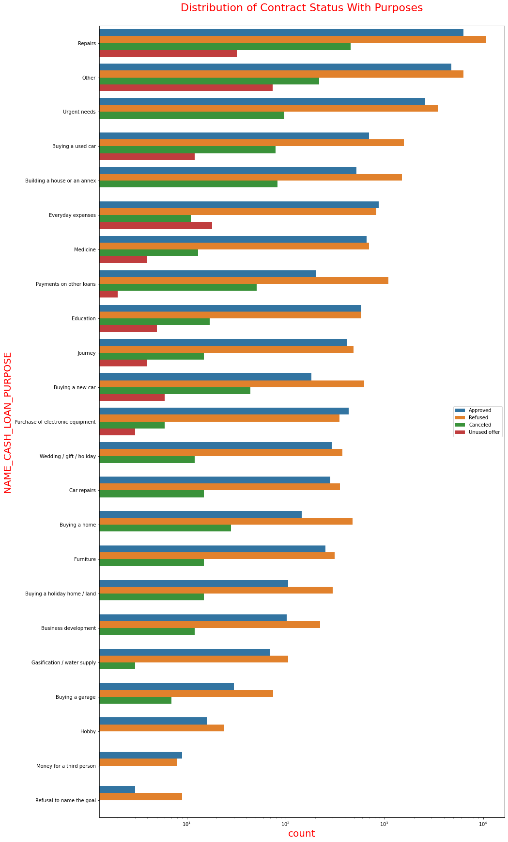
Application & Previous Application Dataset
OBSERVATION
Most rejection of loans and approved were came from purpose 'repairs'.
For education purposes we have equal number of approves and rejection
Paying other loans and buying a new car is having significant higher rejection than approves.

Slide 24
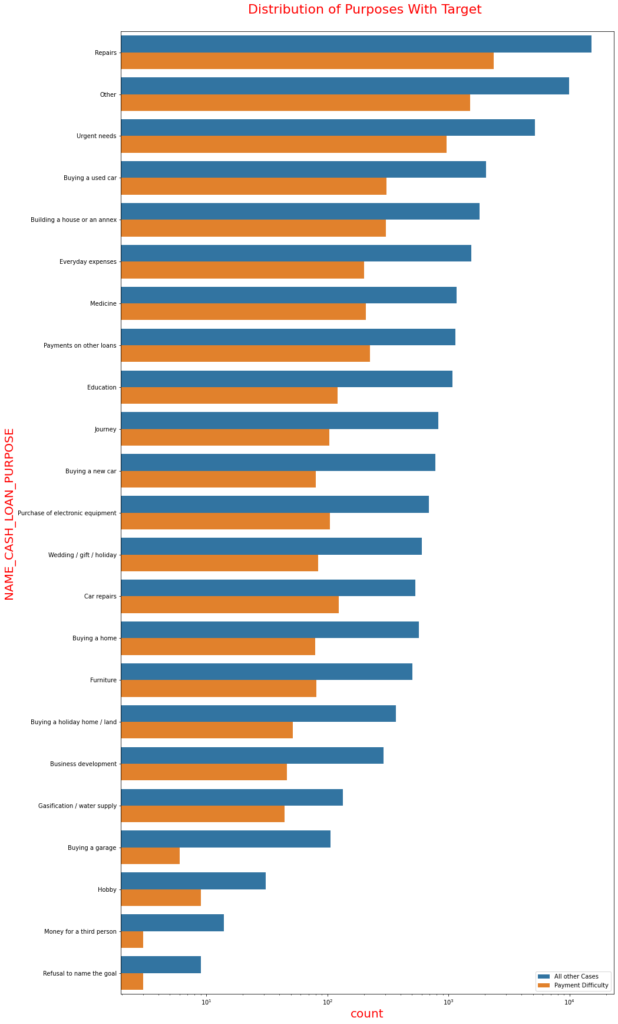
Application & Previous Application Dataset
OBSERVATION
Repairs holds maximum spread on both All other cases and payment difficulty customers.
To Summarize, All other cases that is, the customers who are doing the loan payment properly is consistently higher than the payment difficulty customer. Hence, we shall focus more on customers who has no issues on repayment and minimal payment difficulties.

Slide 25
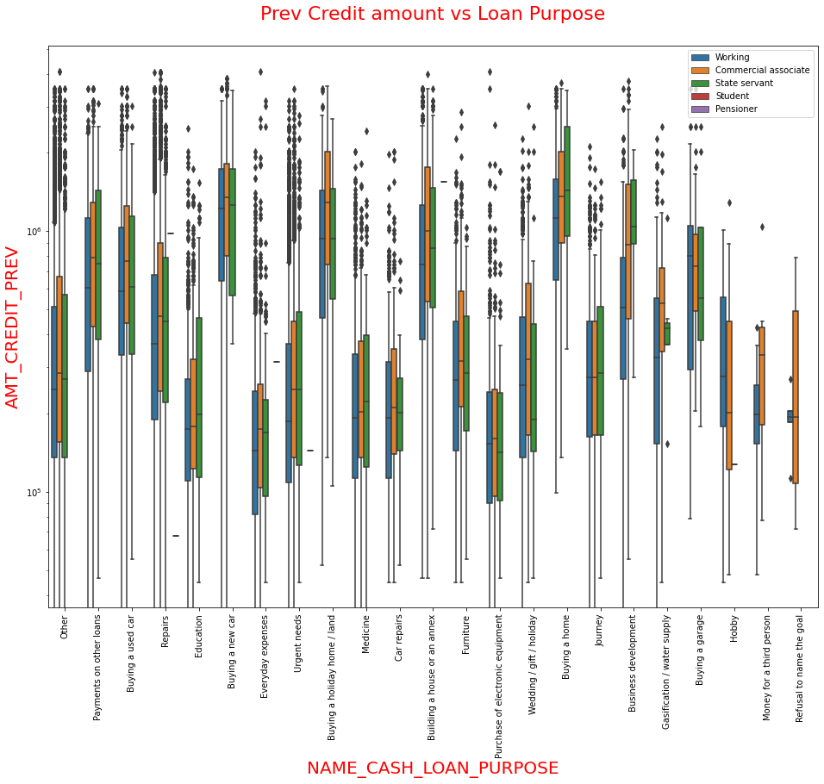
Application & Previous Application Dataset
OBSERVATION
The credit amount of Loan purposes like 'Buying a home', 'Buying a land', 'Buying a new car' and 'Building a house' is higher.
Income type of state servants have a substantial amount of credit applied

Slide 26
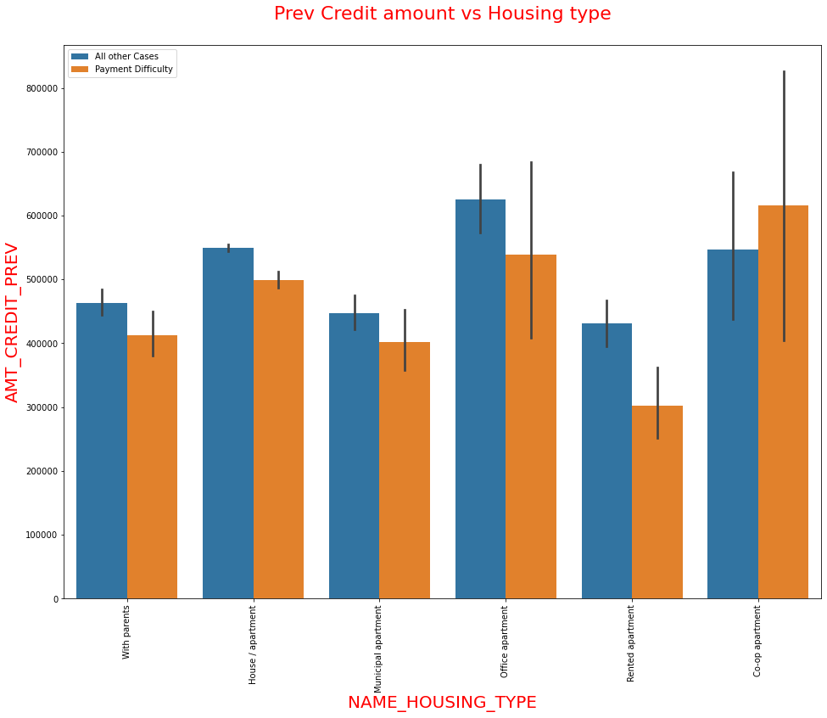
Application & Previous Application Dataset
OBSERVATION
Target – 0 (All other cases) – Housing and Office Apartment has higher credit.
Whereas, target – 1 (Payment Difficulty) – Co-apartment followed by Office apartment has higher credit.

Slide 27
Summary
Customers who are in All other cases holds 91% of spread over Payment Difficulty customer base.
Company should be focusing on Contract Type – Student, Pensioner and Business Man who has housing type except Co-Apartment for Successful payments.
Repairs category has more Payment difficulty customers but it also has same spread on All other cases.
Other category has more unused offer followed by Repairs.
Company can concentrate on Housing type with Parents as they have very less unsuccessful payment.

